Slide 1
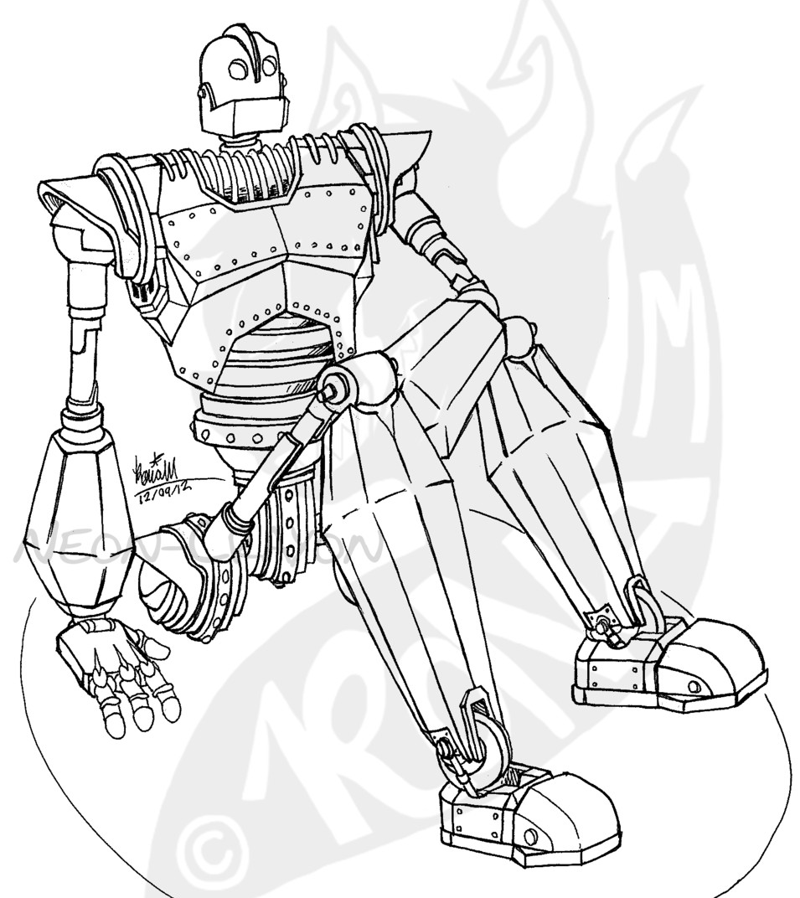
Tajima HS Solis Advisory
Intro to ‘Shading’ – Drawing
Name __________________________________ PER_____ DATE ________________

