Slide 1
AP CALC – DO NOW
Complete the following problem in your PRACTICE NOTEBOOK

Slide 2
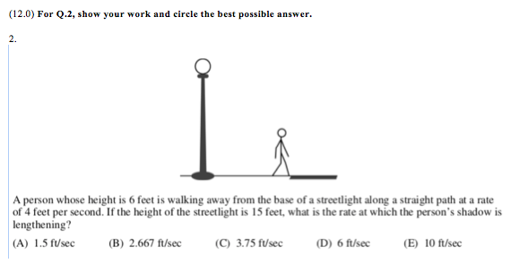
TPS-C What does the problem ask us to find? What plan do you recommend we take?

Slide 3
FRQ – Group Work
All members of the group write
Unpack each part of the problem
This problem wants us to…
Create a plan
To solve this problem we must…
Check your answer (without the scoring guide)
I know my answer is accurate since…
All members of the group present

