Slide 1
AP CALC – DO NOW
Answer the following question in your PRACTICE NOTEBOOK

Slide 2
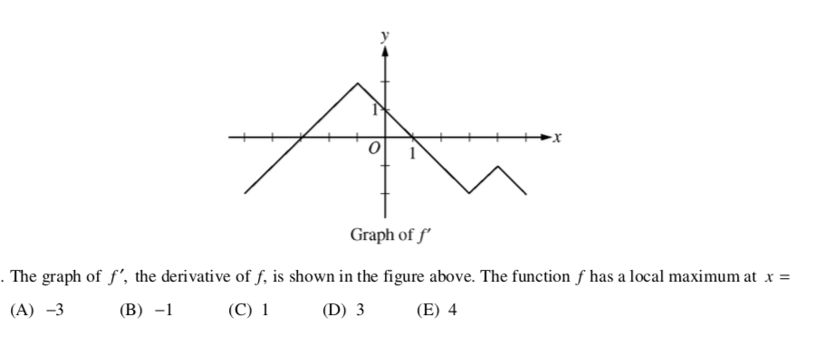
Number Talk

