Slide 1
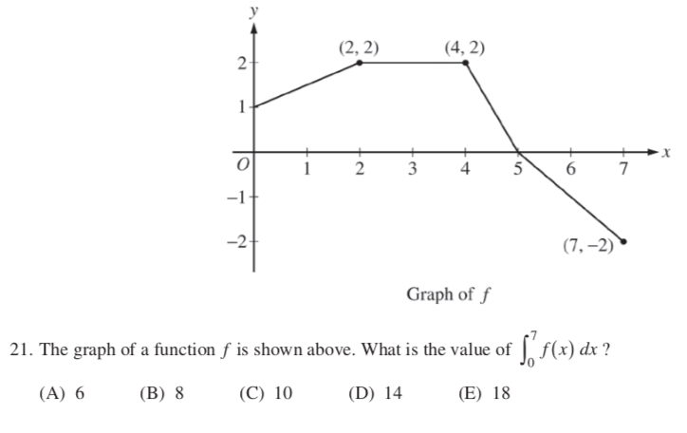
AP CALC BC – DO NOW
Answer the following question in your practice notebook. COPY THE GRAPH!

Slide 2
Quiz this Thursday! Last two standards!

