Slide 1
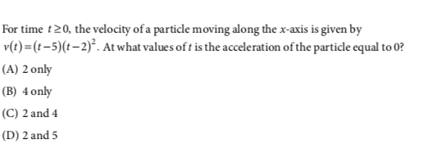
AP CALC – DO NOW

Slide 2
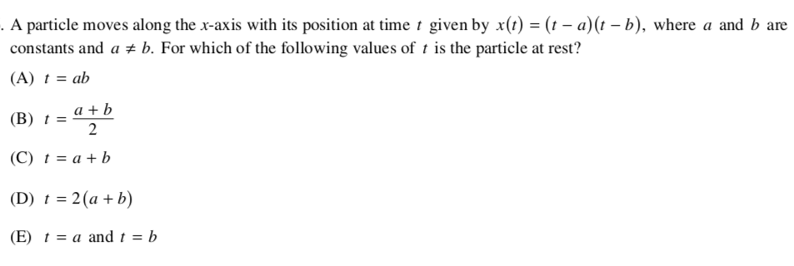
Number Talk

Slide 3
FRQ Sequencing
Unpack Whole group (3min)
Individual (Vol 0) Individual (1min)
Clarifying Questions Whole group (1min)
Pair Work (Vol 2) Pairs (7min)
Share Groups of 4 (2min)
Presentations Whole group (5min)

Slide 4
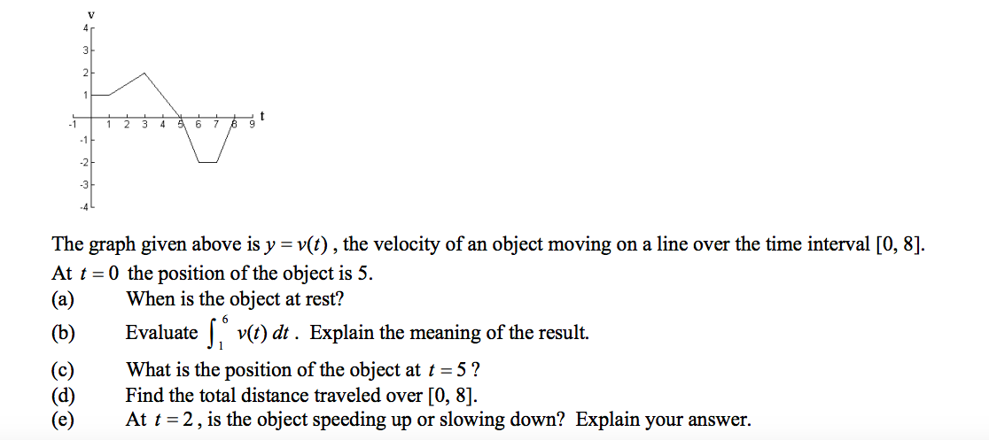

Slide 6
Independent Practice
Weebly → Week 7
Title the practice “Connecting f, f’ and f’’”
Copy the question and graph, if applicable
Show work and check your answers!

Slide 7
Quick Check

Slide 8
Exit Slip

