Slide 1
IM1 – DO NOW
Grab an iPad
Answer the questions provided using the student samples on the
Weebly → Week 14

Slide 2
Assessment on Thursday!
Four standards
Transformations
GCO5, GCO6
Solving Equations
AREIA1, AREIB3

Slide 3
Assessment on Friday!
Four standards
Transformations
GCO5, GCO6
Solving Equations
AREIA1, AREIB3

Slide 4
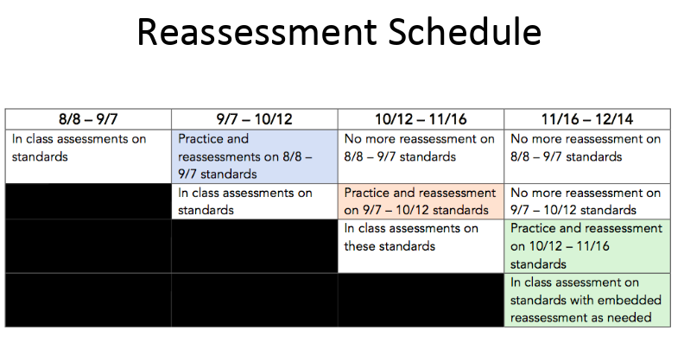

Slide 5
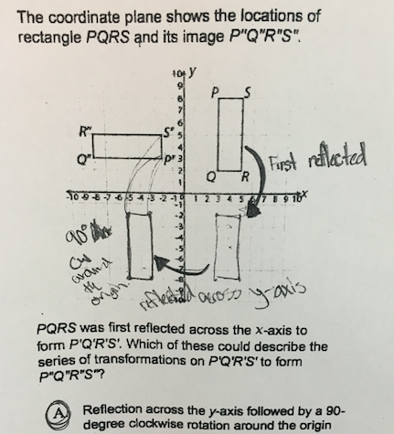
Student Sample 1

Slide 6
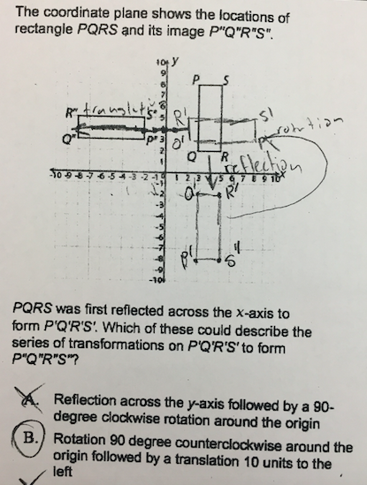
Student Sample 2

Slide 7
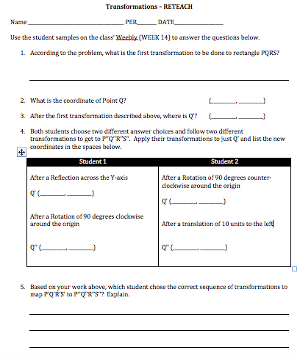

Slide 9
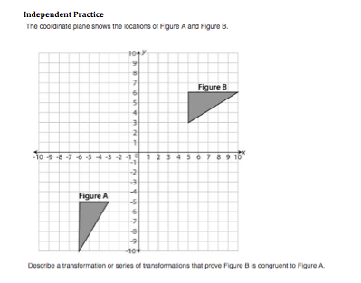

Slide 10
Stations Review
Check your answers from last
week’s quiz
Choose two standards to practice today
For each standard
Complete practice
- Title your work in your
PRACTICE NOTEBOOK with the standard
- You must copy questions and
graphs
Check your answers!
Criteria for each standard (6 problems)
STILL NEED HELP?
Check your notes or practice from previous lessons.
STILL NEED HELP?
Watch a video model and take notes in your NOTES NOTEBOOK

