Slide 1
Question 1 | Your Answer | Standard | Can Grade Be Replaced
1 |  | NQA1 | Yes!
2 |  | NQA1 | Yes!
5 |  | ACED1 | Yes!
6 |  | ACED2 | Yes!
8 |  | AREI10
10 |  | FIFA1
11 |  | FIFA1
12 |  | FIFA3 | Yes!
14 |  | FIFB6
15 |  | FIFB4
16 |  | AREIB3 | Yes!
17 |  | AREIB3 | Yes!
18 |  | ASSEA1
19 |  | ASSEA1
20 |  | ACEDA3
21 |  | ACEDA3
22 |  | SSIDB6
23 |  | SSIDB6
24 |  | SSIDC7
25 |  | SSIDC7
26 |  | GCO6 | Yes!
27 |  | GCO6 | Yes!
28 |  | GCO7 | Yes!
29 |  | GCO7 | Yes!

Slide 2
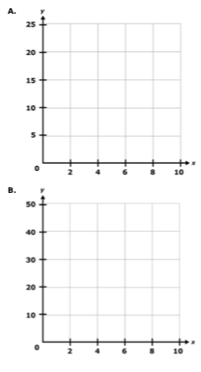
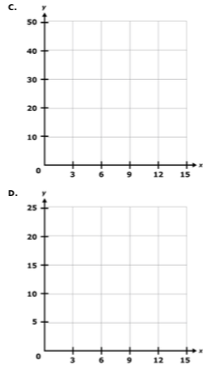
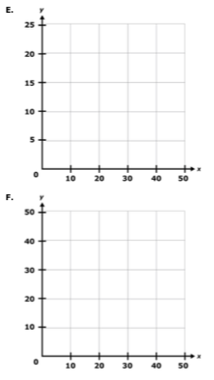

Slide 3
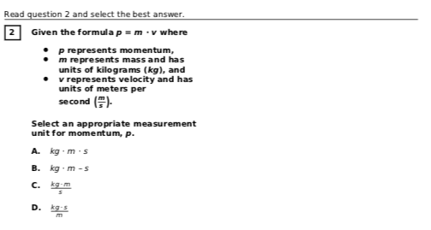
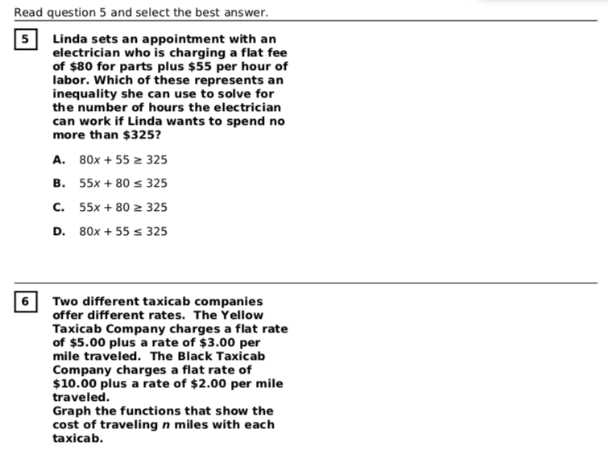
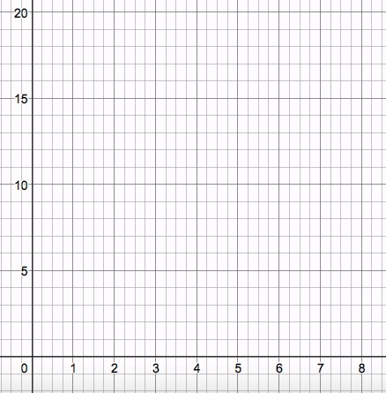

Slide 4
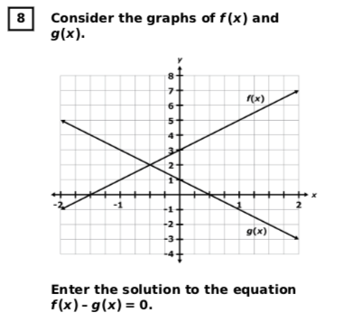
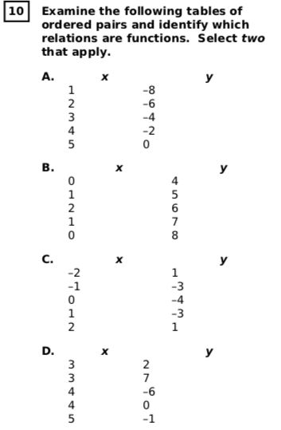

Slide 5
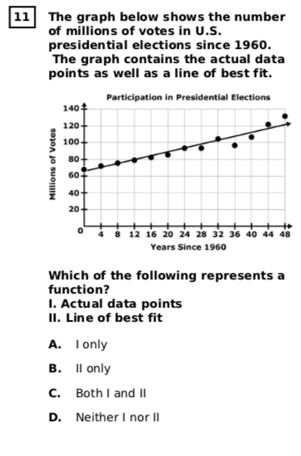
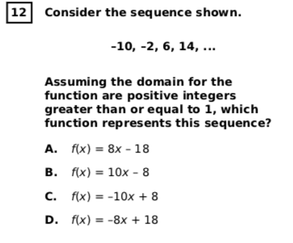

Slide 6
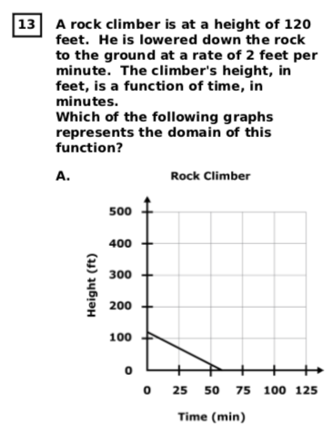
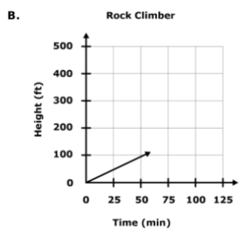

Slide 7
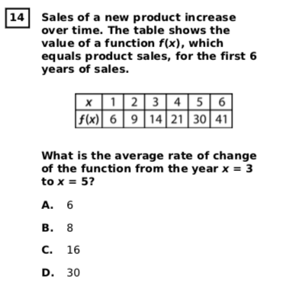
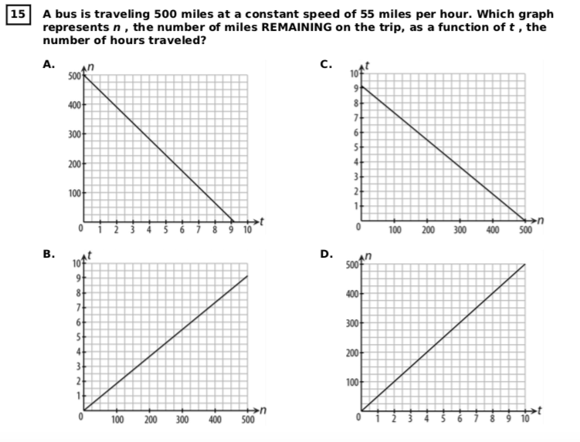

Slide 8
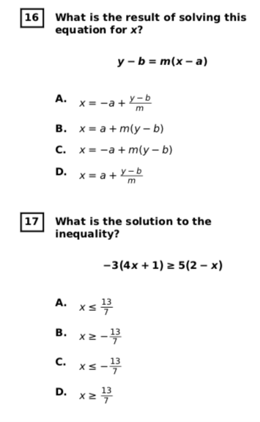
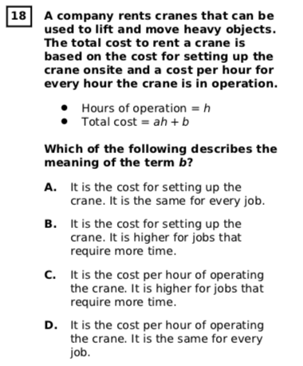
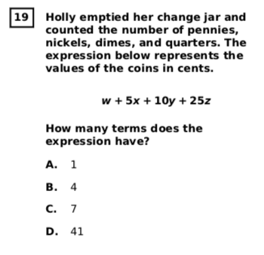

Slide 9
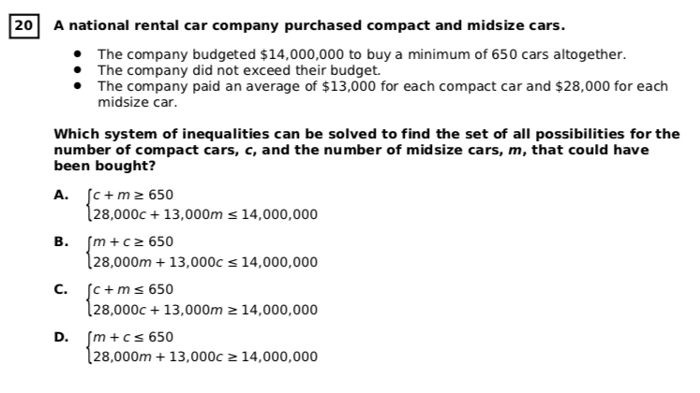

Slide 10
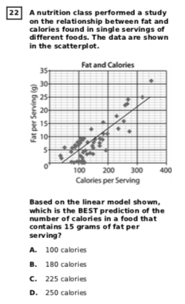
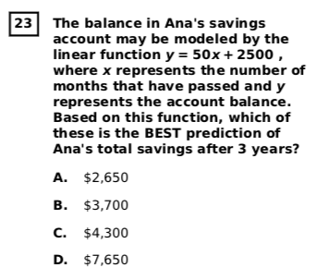

Slide 12
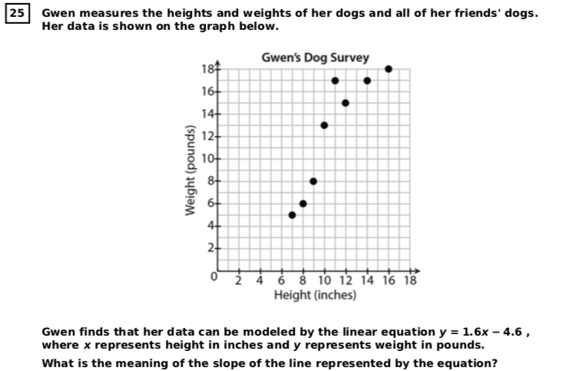
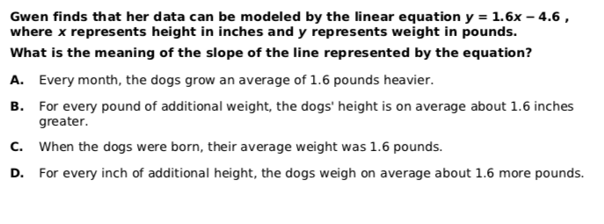

Slide 13
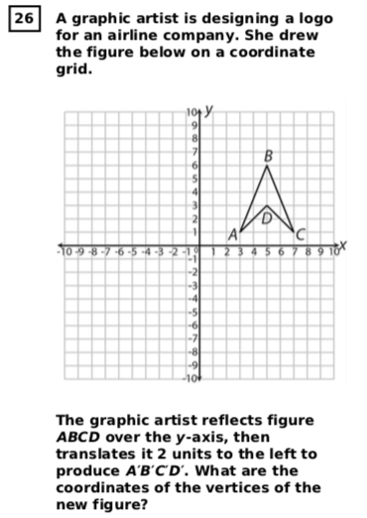
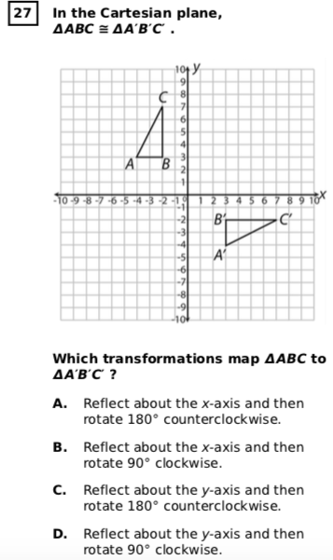
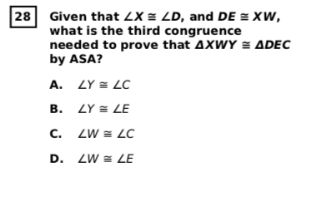

Slide 14
