Slide 1
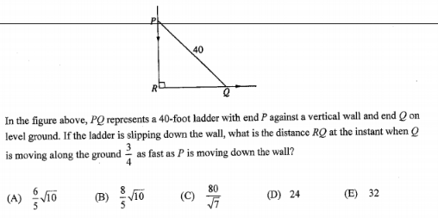
AP CALC – DO NOW

