Slide 1
IM1 – DO NOW (P.7)
Go to the Weebly → Week 24
And read the message under “THURSDAY (Period 7)”
Will two people please pass out folders? Thank you!

Slide 2
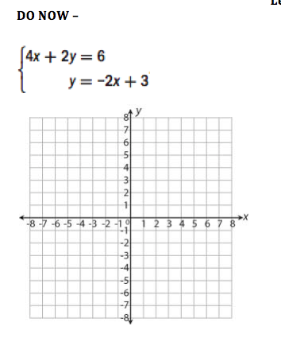
IM1 – DO NOW (3min)
Check your answer on the next slide after 3 minutes!

Slide 3
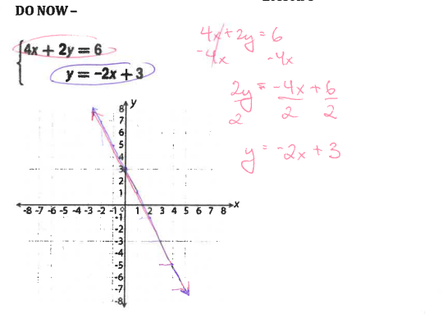

Slide 4
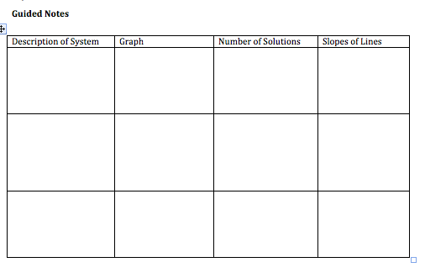
Copy the Chart on the next slide and try the three problems below it (5min)

Slide 5
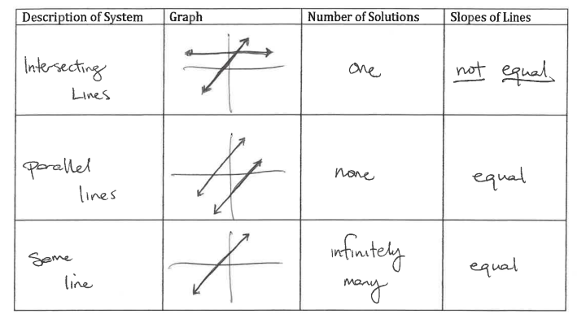
Try the three problems below the chart and check your answers on the next slide!

Slide 7
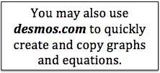
Complete the Exploration (10-15min) If you need a HINT, you may look on the next slide. After you check, write your own equation!

Slide 8
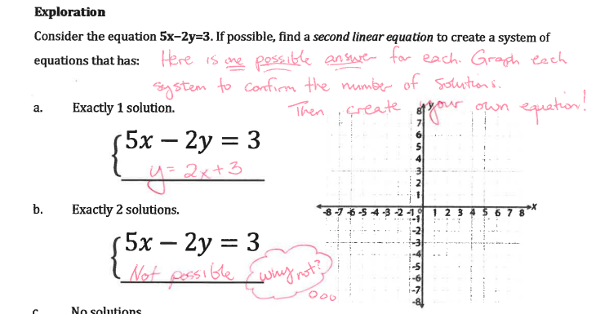

Slide 9
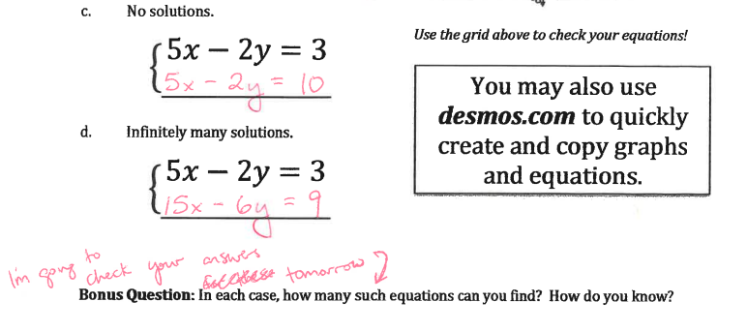

Slide 10
Independent Practice (15min)
Complete the three practice problems provided. Then, check your answers on the next slide.
Afterwards, click the ‘Independent Practice’ button on the Weebly and complete 8 more problems.

Slide 11
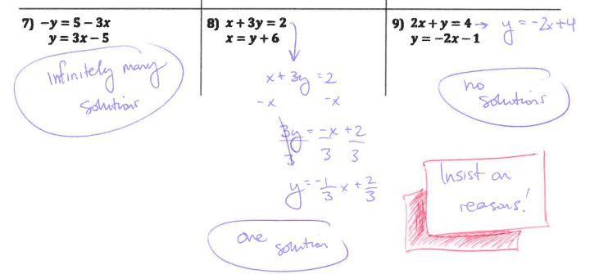
Same Slope, but different y-intercept!

Slide 12
Independent Practice
Rewrite the equations, if necessary.
Graph the two equations
Answer the prompt in a complete sentence and state the reason!

Slide 13
Complete the Exit Slip!
Then submit it and ask for a System of Equations Puzzle.

